Slide 1
LIBRARY MANAGEMENT
Adhithya Sankar

Slide 2
Data Flow Diagram

Slide 3
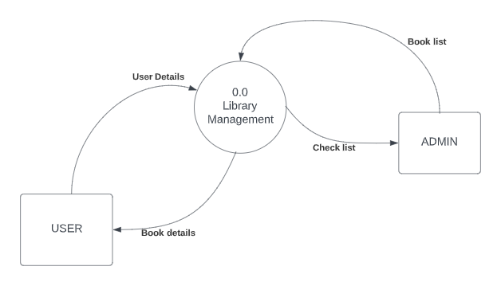
Context Diagram

Slide 4
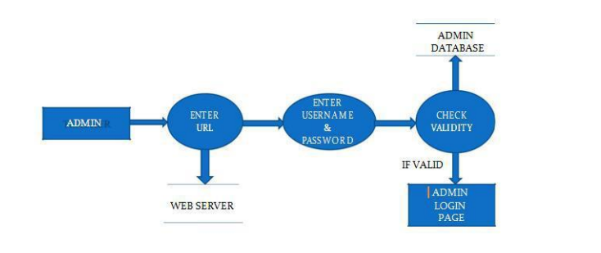
DATA FLOW DIAGRAM FOR ADMINISTRATOR LOGIN

Slide 5
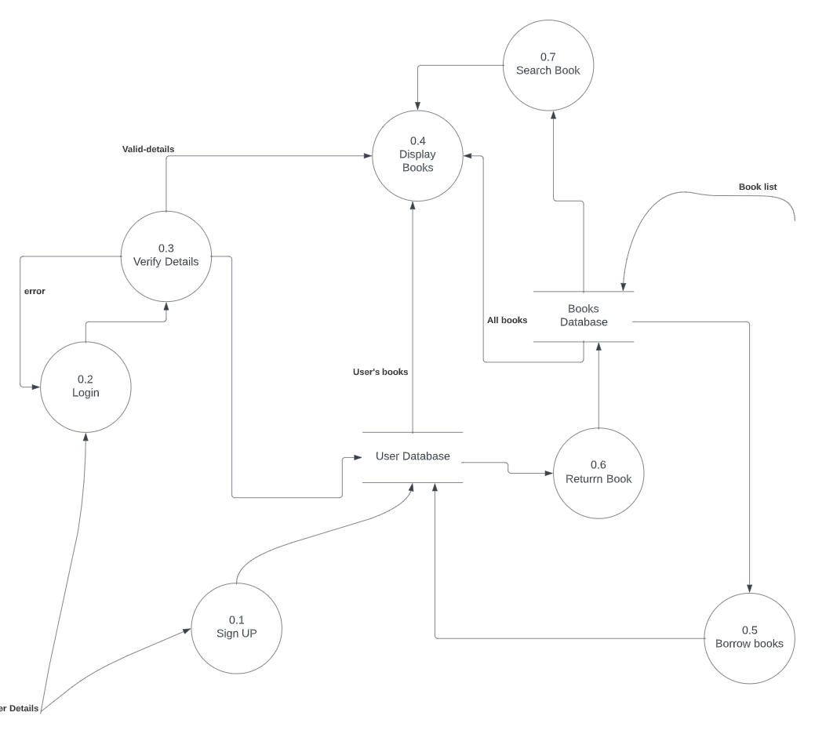
Level 1 Data Flow Diagram

Slide 6
WORKFLOW

Slide 7
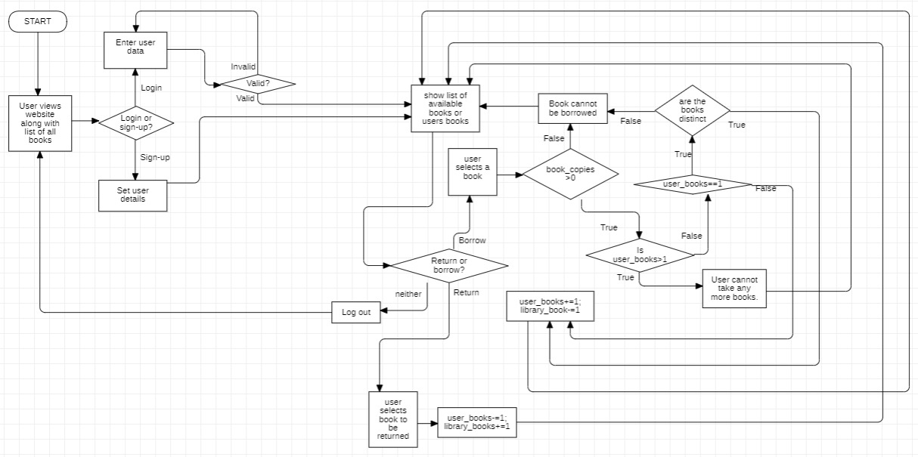
Flowchart

Slide 8
THANK YOU

